Slide 2
C++
2019

Slide 3
Hello
/** First C++ program that says hello (hello.cpp) */
#include <iostream> // Needed to perform IO operations
using namespace std;
int main() { // Program entry point
cout << "hello, world" << endl; // Say Hello
return 0; // Terminate main()
}
The directive "#include <iostream>" tells the preprocessor to include the "iostream" header file to support input/output operations.
The "using namespace std;" statement declares std as the default namespace used in this program. The names cout and endl, which is used in this program, belong to the std namespace.
These two lines shall be present in all our programs.

Slide 4
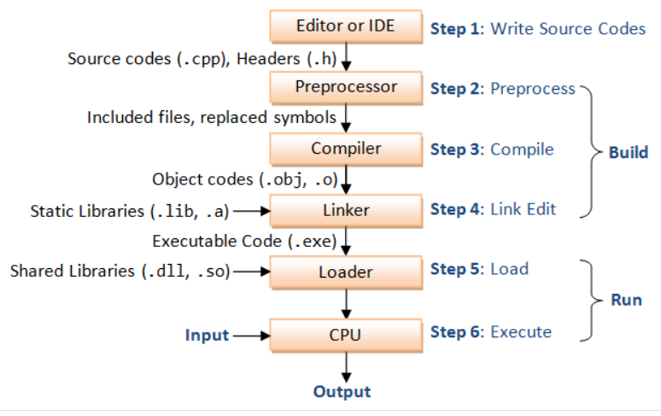
Step 1: Write the source codes (.cpp) and header files (.h).
Step 2: Pre-process the source codes according to the preprocessor directives. Preprocessor directives begin with a hash sign (#), e.g., #include and #define.
Step 3: Compile the pre-processed source codes into object codes (.obj, .o).
Step 4: Link the compiled object codes with other object codes and the library object codes (.lib, .a) to produce the executable code (.exe).
Step 5: Load the executable code into computer memory.
Step 6: Run the executable code, with the input to produce the desiried output

Slide 5
Template
/*
* Comment to state the purpose of this program (filename.cpp)
*/
#include <iostream>
using namespace std;
int main() {
// Your Programming statements HERE!
return 0;
}

Slide 6
Output via "cout <<"
cout << "hello" << " world, " << "again!" << endl;
hello world, again!
cout << "hello," << endl << "one more time. " << endl << 5 << 4 << 3 << " " << 2.2 << " " << 1.1 << endl;
hello,
one more time.
543 2.2 1.1
cout << "hello world, again!\n";
cout << "\thello,\none\tmore\ttime.\n";
hello world, again!
hello,
one more time.
_

Slide 7
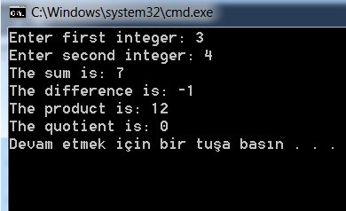
Input via "cin >>"
#include <iostream>
using namespace std;
int main() {
int firstInt, secondInt, sum, difference, product, quotient;
cout << "Enter first integer: "; // Display a prompting message
cin >> firstInt; // Read input from keyboard (cin) into firstInt
cout << "Enter second integer: "; //Display a prompting message
cin >> secondInt; // Read input into secondInt
sum = firstInt + secondInt;
difference = firstInt - secondInt;
product = firstInt * secondInt;
quotient = firstInt / secondInt;
cout << "The sum is: " << sum << endl;
cout << "The difference is: " << difference << endl;
cout << "The product is: " << product << endl;
cout << "The quotient is: " << quotient << endl;
return 0;
}

Slide 8
Reading multiple items in one cin statement
cout << "Enter two integers (separated by space): "; // Put out a prompting message
cin >> firstInt >> secondInt; // Read two values into respective variables
sum = firstInt + secondInt;
cout << "The sum is: " << sum << endl;

Slide 9
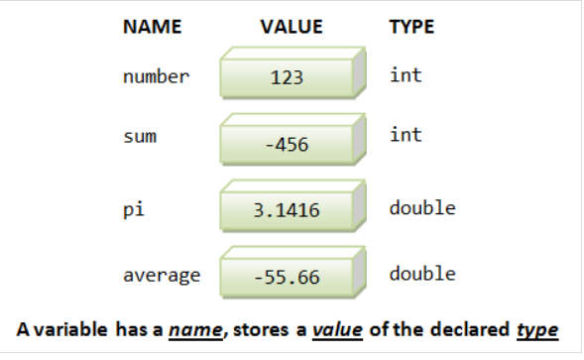
What is a Variable?
// Syntax: Declare a variable of a type
var-type var-name;
int sum; // Example:
double radius;
// Declare multiple variables of the same type
var-type var-name-1, var-name-2,...;
int sum, difference, product, quotient; // Example:
double area, circumference;
// Declare a variable of a type and assign an initial value
var-type var-name = initial-value;
int sum = 0; // Example:
double pi = 3.14159265;
// Syntax: Declare multiple variables of the same type with initial values
var-type var-name-1 = initial-value-1, var-name-2 = initial-value-2,... ;
int firstNumber = 1, secondNumber = 2; // Example:

Slide 10
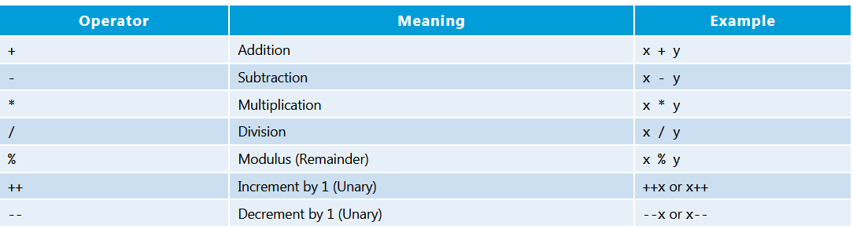
Basic Arithmetic Operations

Slide 11
Type double & Floating-Point Numbers
Recall that a variable in C/C++ has a name and a type, and can hold a value of only that particular type.
We have so far used a type called int. A int variable holds only integers (whole numbers), such as 123 and -456.
In programming, real numbers such as 3.1416 and -55.66 are called floating-point numbers, and belong to a type called double.
You can express floating-point numbers in fixed notation (e.g., 1.23, -4.5) or scientific notation (e.g., 1.2e3, -4E5.6) where e or E denote the exponent of base 10.

Slide 12
Mixing int and double, and Type Casting
Although you can use a double to keep an integer value (e.g., double count = 5), you should use an int for integer. This is because int is far more efficient than double, in terms of running times and memory requirement.
Arithmetic operations ('+', '-', '*', '/') of two int's produce an int;
while arithmetic operations of two double's produce a double.
Hence, 1/2 → 0 (take note!) and 1.0/2.0 → 0.5.
Arithmetic operations of an int and a double produce a double.
Hence, 1.0/2 → 0.5 and 1/2.0 → 0.5.
You can assign an integer value to a double variable.
The integer value will be converted to a double value automatically,
e.g., 3 → 3.0.

Slide 13
int i = 3;
double d;
d = i; // 3 → 3.0, d = 3.0
d = 88; // 88 → 88.0, d = 88.0
double nought = 0; // 0 → 0.0; there is a subtle difference between int of 0 and double of 0.0
However, if you assign a double value to an int variable, the fractional part will be lost. For example,
double d = 55.66;
int i;
i = d; // i = 55 (truncated)

Slide 14
Type Casting Operators
If you are certain that you wish to carry out the type conversion, you could use the so-called type cast operator.
The type cast operation could take one of these forms in C++, which returns an equivalent value in the new-type specified.
new-type(expression); // C++ function cast notation
(new-type)expression; // C-language cast notation
or example,
double d = 5.5;
int i;
i = int(d); // int(d) -> int(5.5) -> 5 (assigned to i)
i = int(3.1416); // int(3.1416) -> 3 (assigned to i)
i = (int)3.1416; // same as above

Slide 15
Floating-point Literals
A number with a decimal point, such as 55.66 and -33.44, is treated as a double, by default.
You can also express them in scientific notation, e.g., 1.2e3, -5.5E-6, where e or E denotes the exponent in power of 10.
You could precede the fractional part or exponent with a plus (+) or minus (-) sign. Exponent shall be an integer. There should be no space or other characters (e.g., space) in the number.
You MUST use a suffix of 'f' or 'F' for float literals, e.g., -1.2345F. For example,
float average = 55.66; // Error! RHS is a double. Need suffix 'f' for float.
float average = 55.66f;

Slide 16

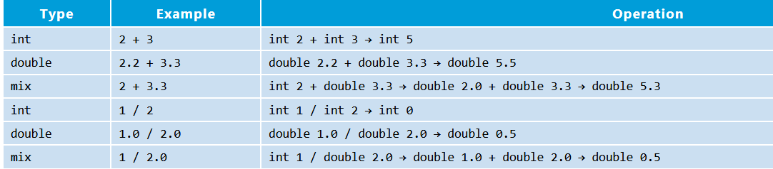

Slide 17
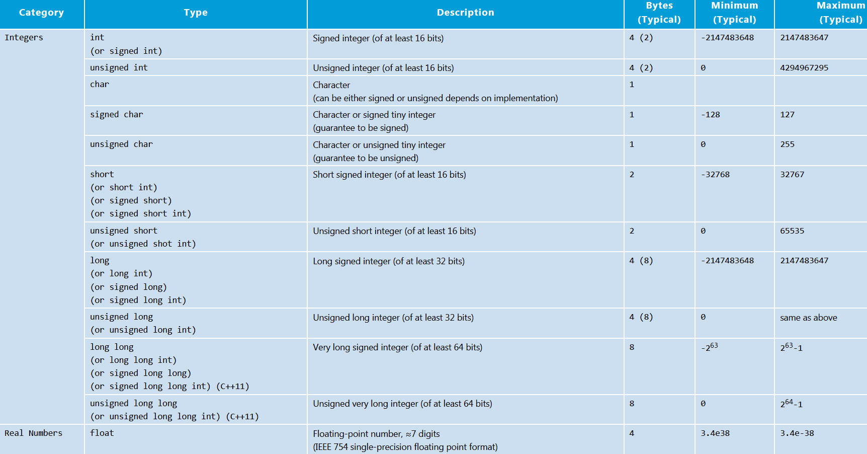
Fundamental Types

Slide 18
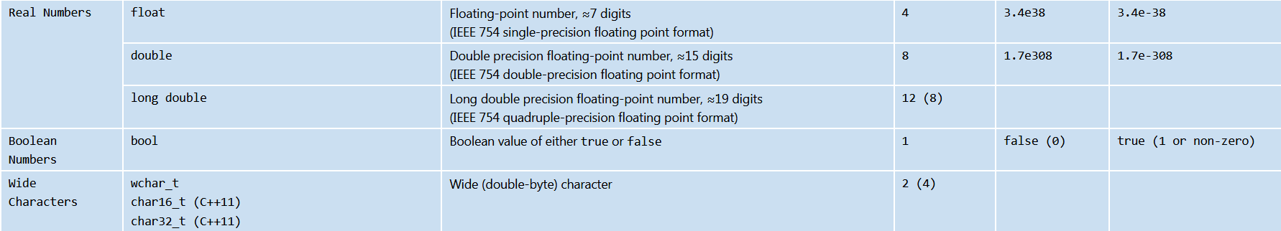

Slide 19
Character Literals and Escape Sequences
In C++, characters are represented using 8-bit ASCII code, and can be treated as a 8-bit signed integers in arithmetic operations.
In other words, char and 8-bit signed integer are interchangeable. You can also assign an integer in the range of [-128, 127] to a char variable; and [0, 255] to an unsigned char.
For example,
char letter = 'a'; // Same as 97
char anotherLetter = 98; // Same as the letter 'b'
cout << letter << endl; // 'a' printed
cout << anotherLetter << endl; // 'b' printed instead of the number
anotherLetter += 2; // 100 or 'd'
cout << anotherLetter << endl; // 'd' printed
cout << (int)anotherLetter << endl; // 100 printed

Slide 20
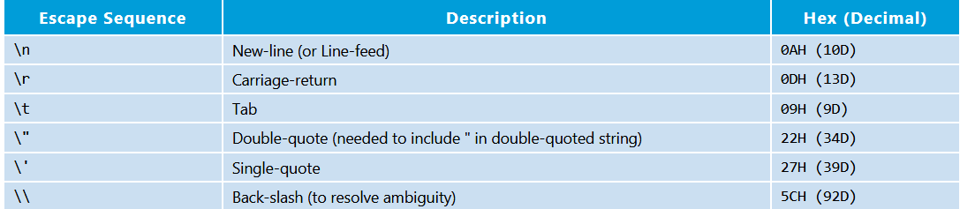

Slide 21
String Literals
A String literal is composed of zero of more characters surrounded by a pair of double quotes, e.g., "Hello, world!", "The sum is ", "". For example,
String directionMsg = "Turn Right";
String greetingMsg = "Hello";
String statusMsg = ""; // empty string
String literals may contains escape sequences.
Inside a String, you need to use \" for double-quote to distinguish it from the ending double-quote, e.g. "\"quoted\"". Single quote inside a String does not require escape sequence. For example,
cout << "Use \\\" to place\n a \" within\ta\tstring" << endl;
Use \" to place
a " within a string

Slide 22
bool Literals
There are only two bool literals, i.e., true and false. For example,
bool done = true;
bool gameOver = false;
int i;
if (i == 9) { // returns either true or false
......
}
In an expression, bool values and literals are converted to int 0 for false and 1 (or a non-zero value) for true.

Slide 23
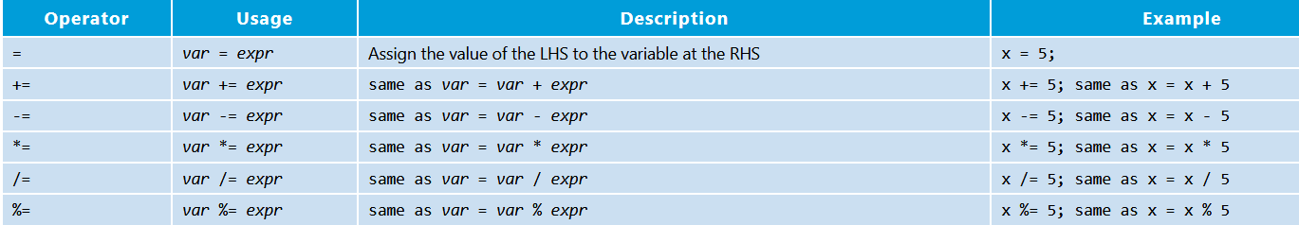
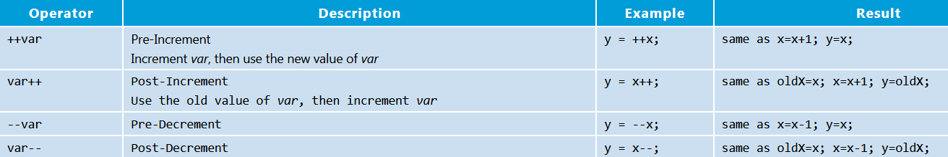
Compound Assignment Operators
Increment/Decrement Operators

Slide 24
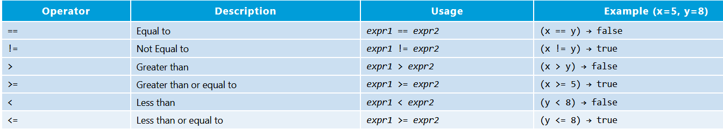
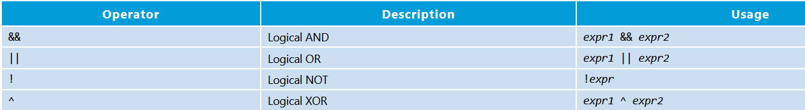
Relational and Logical Operators

Slide 25
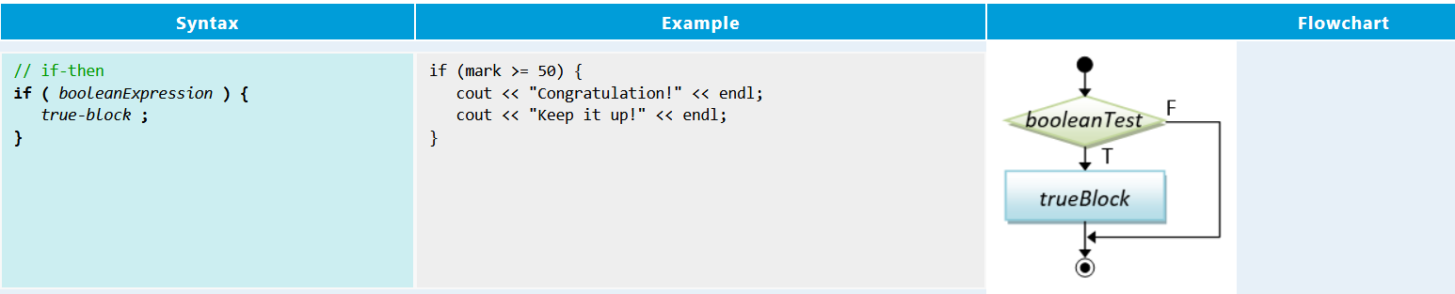
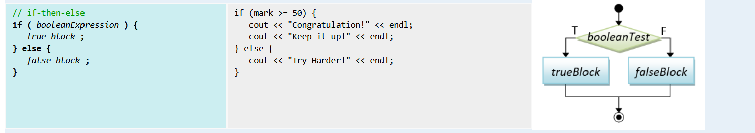
Conditional (Decision) Flow Control

Slide 26
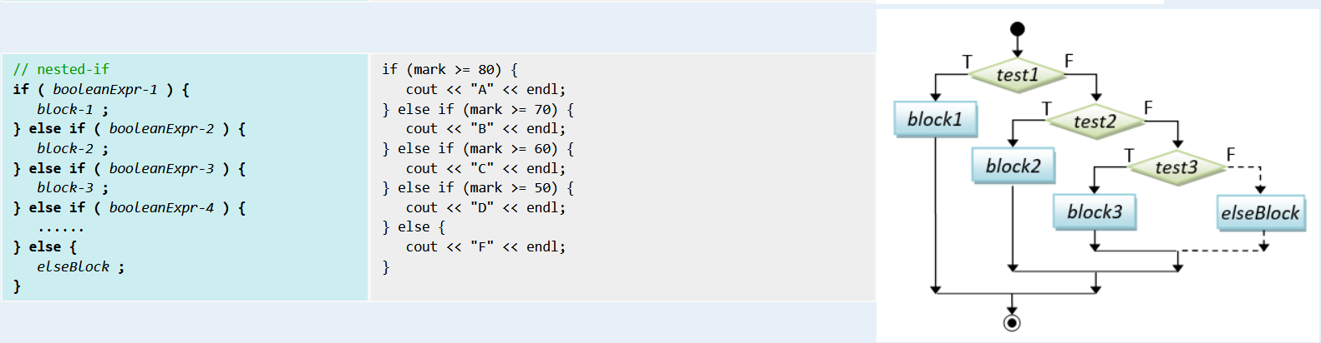

Slide 27
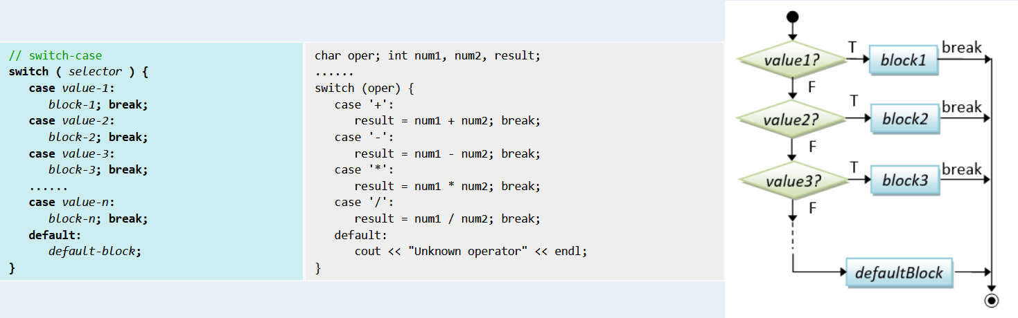

Slide 28
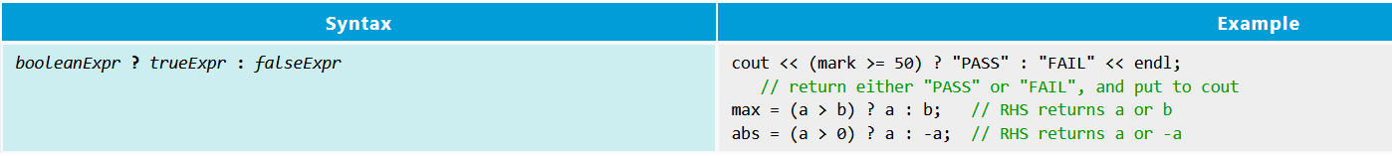
Conditional Operator:

Slide 29
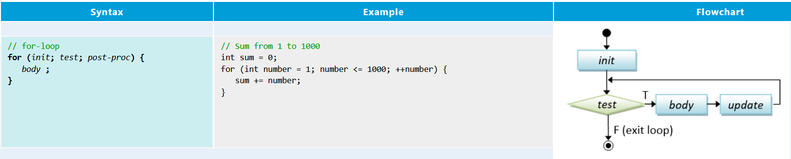
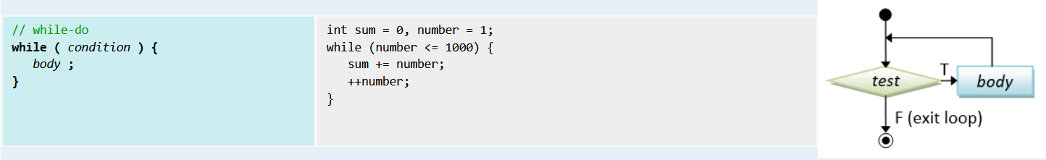
Loop Flow Control

Slide 30
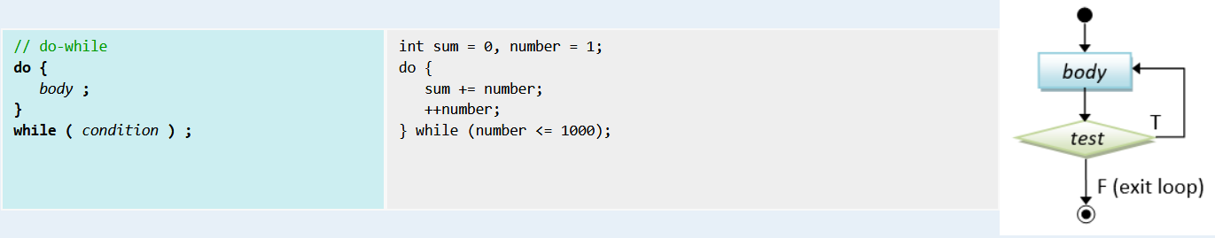

Slide 31
/* * Sum from 1 to a given upperbound and compute their average (SumNumbers.cpp) */
#include <iostream>
using namespace std;
int main() {
int sum = 0; // Store the accumulated sum
int upperbound;
cout << "Enter the upperbound: ";
cin >> upperbound;
for (int number = 1; number <= upperbound; ++number) { // Sum from 1 to the upperbound
sum += number;
}
cout << "Sum is " << sum << endl;
cout << "Average is " << (double)sum / upperbound << endl;
int count = 0; // Sum only the odd numbers // counts of odd numbers
sum = 0; // reset sum
for (int number=1; number <= upperbound; number=number+2) {
++count;
sum += number;
}
cout << "Sum of odd numbers is " << sum << endl;
cout << "Average is " << (double)sum / count << endl;
}

Slide 32
Interrupting Loop Flow - "break" and "continue"
#include <iostream>
using namespace std;
int main() {
int number = 1;
while (true) {
++number;
if ((number % 3) == 0) continue;
if (number == 133) break;
if ((number % 2) == 0) {
number += 3;
} else {
number -= 3;
}
cout << number << " ";
}
cout << endl;
return 0; }

Slide 33
Terminating Program
There are a few ways that you can terminate your program, before reaching the end of the programming statements.
exit(): You could invoke the function exit(int exitCode), in <cstdlib> (ported from C's "stdlib.h"), to terminate the program and return the control to the Operating System. By convention, return code of zero indicates normal termination; while a non-zero exitCode (-1) indicates abnormal termination.
abort(): The header <cstdlib> also provide a function called abort(), which can be used to terminate the program abnormally.
if (errorCount > 10) {
cout << "too many errors" << endl;
exit(-1); // Terminate the program// OR abort();
}
You could also use a "return returnValue" statement in the main() function to terminate the program and return control back to the Operating System.
int main() {
...
if (errorCount > 10) {
cout << "too many errors" << endl;
return -1; // Terminate and return control to OS from main()
}
...}

Slide 34
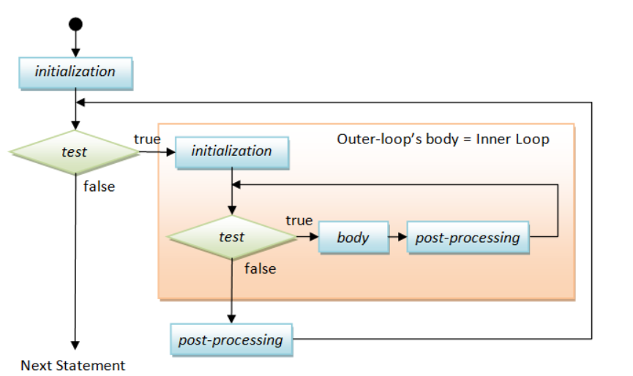
Nested Loops

Slide 35
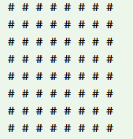
/*Print square pattern */
#include <iostream>
using namespace std;
int main() {
int size = 8;
for (int row = 1; row <= size; ++row) { // Outer loop to print all the rows
for (int col = 1; col <= size; ++col) { // Inner loop to print all the columns of each row
cout << "# ";
}
cout << endl; // A row ended, bring the cursor to the next line
}
return 0;
}

Slide 36
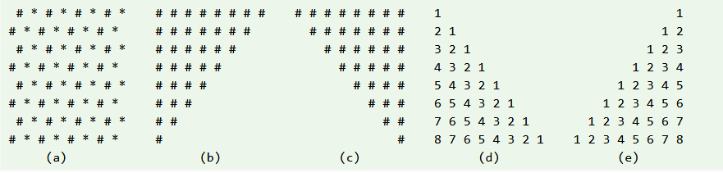
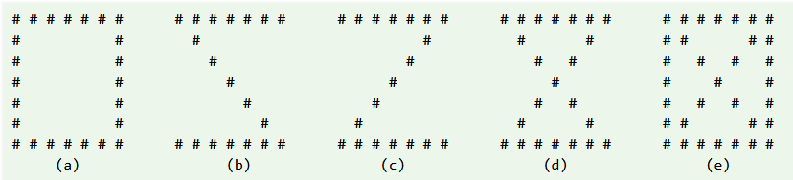

Slide 37
Dangling else: The "dangling else" problem can be illustrated as follows:
if (i == 0)
if (j == 0)
cout << "i and j are zero" << endl;
else cout << "i is not zero" << endl; // intend for the outer-if
The else clause in the above codes is syntactically applicable to both the outer-if and the inner-if.
The C++ compiler always associate the else clause with the innermost if (i.e., the nearest if).
Dangling else can be resolved by applying explicit parentheses. The above codes are logically incorrect and require explicit parentheses as shown below.
if ( i == 0) {
if (j == 0) cout << "i and j are zero" << endl;
} else {
cout << "i is not zero" << endl; // non-ambiguous for outer-if
}

Slide 38
Strings
C++ supports two types of strings:
the original C-style string: A string is a char array, terminated with a NULL character '\0' (Hex 0).
the new string class introduced in C++98.
The "high-level" string class is recommended. However, avoid C-string unless it is absolutely necessary.
String Declaration and Initialization
To use the string class, include the <string> header and "using namespace std".
You can declare and (a) initialize a string with a string literal, (b) initialize to an empty string, or (c) initialize with another string object. For example,
#include <string>
using namespace std;
string str1("Hello"); // Initialize with a string literal (Implicit initialization)
string str2 = "world"; // Initialize with a string literal (Explicit initialization via assignment operator)
string str3; // Initialize to an empty string
string str4(str1); // Initialize by copying from an existing string object

Slide 39
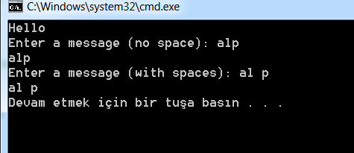
#include <iostream> /* Testing string class input and output */
#include <string> // Need this header to use string class
#include <limits>
using namespace std; // Also needed for <string>
int main() {
string message("Hello");
cout << message << endl;
cout << "Enter a message (no space): "; // Input a word (delimited by space) into a string
cin >> message;
cout << message << endl;
cin.ignore(numeric_limits<streamsize>::max(), '\n'); // flush cin up to newline (need <limits> header)
cout << "Enter a message (with spaces): "; // Input a line into a string
getline(cin, message); // Read input from cin into message
cout << message << endl;
return 0;
}

Slide 40
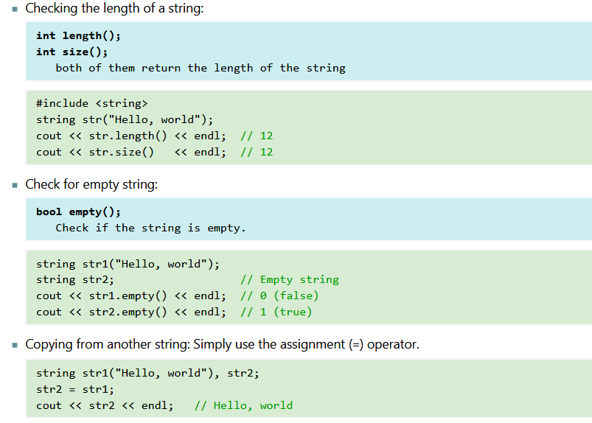
String Operations

Slide 41
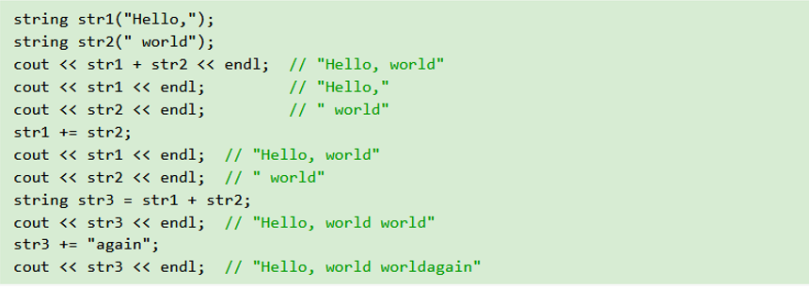

Slide 42
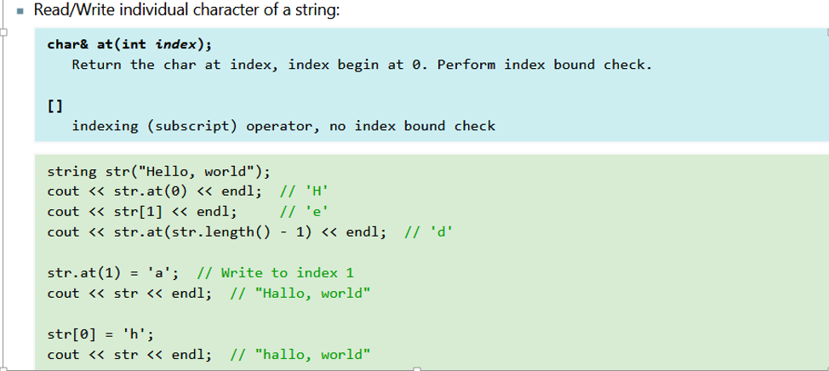

Slide 43
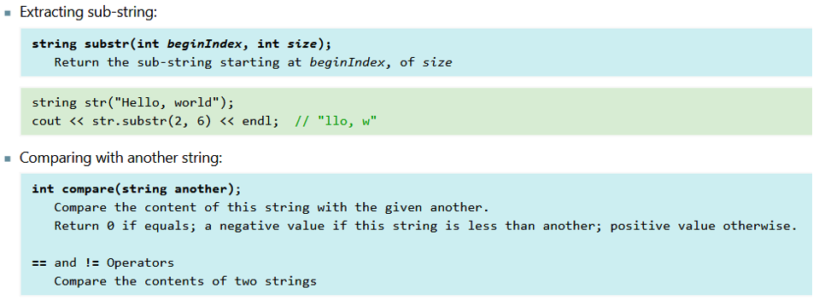

Slide 44
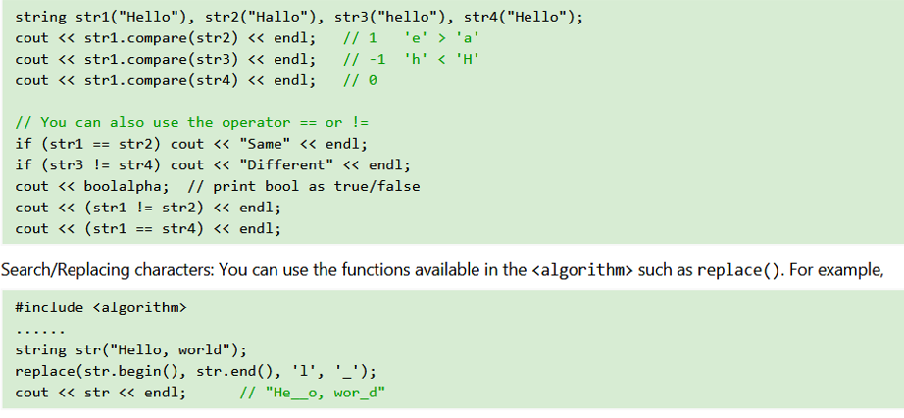

Slide 45
Formatting Input/Output using IO Manipulators (Header <iomanip>)
The <iomanip> header provides so-called I/O manipulators for formatting input and output:
setw(int field-widht): set the field width for the next IO operation.
setw() is non-sticky and must be issued prior to each IO operation. The field width is reset to the default after each operation
setfill(char fill-char): set the filled character for padding to the field width.
left|right|internal: set the alignment
fixed/scientific (for floating-point numbers): use fixed-point notation (e.g, 12.34) or scientific notation (e.g., 1.23e+006).
setprecision(int numDecimalDigits) (for floating-point numbers): specify the number of digits after the decimal point.
boolalpha/noboolalpha (for bool): display bool values as alphabetic string (true/false) or 1/0.

Slide 46
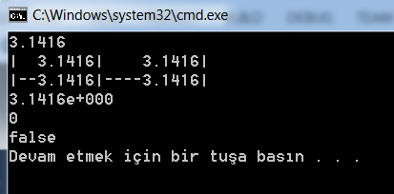
Output Formatting
#include <iostream> /* Test Formatting Output */
#include <iomanip> // Needed to do formatted I/O
using namespace std;
int main() {
double pi = 3.14159265; // Floating point numbers
cout << fixed << setprecision(4); // fixed format with 4 decimal places
cout << pi << endl;
cout << "|" << setw(8) << pi << "|" << setw(10) << pi << "|" << endl;
cout << setfill('-'); // setw() is not sticky, only apply to the next operation.
cout << "|" << setw(8) << pi << "|" << setw(10) << pi << "|" << endl;
cout << scientific; // in scientific format with exponent
cout << pi << endl;
bool done = false; // booleans
cout << done << endl; // print 0 (for false) or 1 (for true)
cout << boolalpha; // print true or false
cout << done << endl;
return 0;}

Slide 47
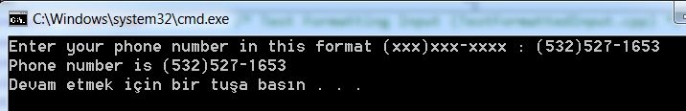
Input Formatting
#include <iostream> /* Test Formatting Input */
#include <iomanip> #include <string>
using namespace std;
int main() {
string areaCode, phoneCode;
string inStr;
cout << "Enter your phone number in this format (xxx)xxx-xxxx : ";
cin.ignore(); // skip '('
cin >> setw(3) >> areaCode;
cin.ignore(); // skip ')'
cin >> setw(3) >> phoneCode;
cin.ignore(); // skip '-'
cin >> setw(4) >> inStr;
phoneCode += inStr;
cout << "Phone number is (" << areaCode << ")"
<< phoneCode.substr(0, 3) << "-"
<< phoneCode.substr(3, 4) << endl;
return 0;}

Slide 48
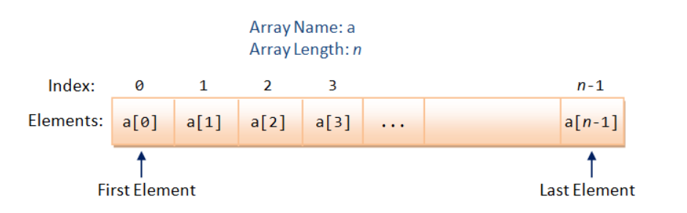
Arrays: Array Declaration and Usage
type arrayName[arraylength]; // arraylength can be a literal or a variable
int marks[5]; // Declare an int array called marks with 5 elements
double numbers[10]; // Declare an double array of 10 elements
const int SIZE = 9;
float temps[SIZE]; // Use const int as array length
int size; // Some compilers support an variable as array length, e.g.,
cout << "Enter the length of the array: ";
cin >> size;
float values[size];

Slide 49
// Declare and initialize an int array of 3 elements
int numbers[3] = {11, 33, 44};
// If length is omitted, the compiler counts the elements
int numbers[] = {11, 33, 44};
// Number of elements in the initialization shall be equal to or less than length
int numbers[5] = {11, 33, 44}; // Remaining elements are zero. Confusing! Don't do this
int numbers[2] = {11, 33, 44}; // ERROR: too many initializers
// Use {0} or {} to initialize all elements to 0
int numbers[5] = {0}; // First element to 0, the rest also to zero
int numbers[5] = {}; // All element to 0 too

Slide 50
#include <iostream>/* Find the mean and standard deviation of numbers kept in an array */
#include <iomanip>
#include <cmath>
#define SIZE 7
using namespace std;
int main() {
int marks[] = {74, 43, 58, 60, 90, 64, 70};
int sum = 0;
int sumSq = 0;
double mean, stdDev;
for (int i = 0; i < SIZE; ++i) {
sum += marks[i];
sumSq += marks[i]*marks[i];
}
mean = (double)sum/SIZE;
cout << fixed << "Mean is " << setprecision(2) << mean << endl;
stdDev = sqrt((double)sumSq/SIZE - mean*mean);
cout << fixed << "Std dev is " << setprecision(2) << stdDev << endl;
return 0;
}
Array and Loop

Slide 51
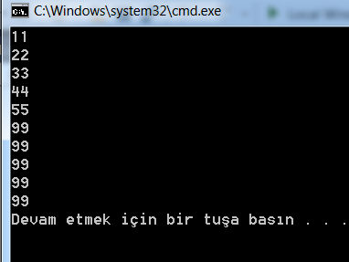
Range-based for loop (C++11)
#include <iostream>/* Testing For-each loop */
using namespace std;
int main() {
int numbers[] = {11, 22, 33, 44, 55};
for (int number : numbers) { // For each member called number of array numbers - read only
cout << number << endl;
}
for (int &number : numbers) { // To modify members, need to use reference (&)
number = 99;
}
for (int number : numbers) {
cout << number << endl;
}
return 0;
}

Slide 52
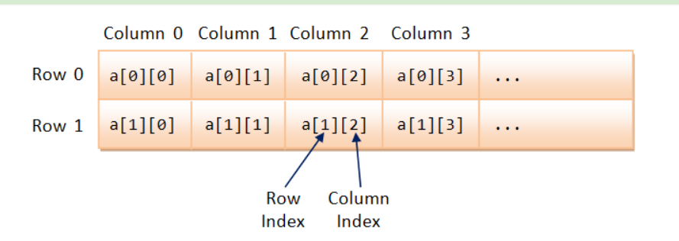
Multi-Dimensional Array

Slide 53
/* Test Multi-dimensional Array */
#include <iostream>
using namespace std;
void printArray(const int[][3], int);
int main() {
int myArray[][3] = {{8, 2, 4}, {7, 5, 2}}; // 2x3 initialized
printArray(myArray, 2); // Only the first index can be omitted and implied
return 0;
}
void printArray(const int array[][3], int rows) {// Print the contents of rows-by-3 array (columns is fixed)
for (int i = 0; i < rows; ++i) {
for (int j = 0; j < 3; ++j) {
cout << array[i][j] << " ";
}
cout << endl;
}
}

Slide 54
Array of Characters - C-String
In C, a string is a char array terminated by a NULL character '\0' (ASCII code of Hex 0).
C++ provides a new string class under header <string>.
The original string in C is known as C-String (or C-style String or Character String). You could allocate a C-string via:
char message[256]; // Declare a char array
// Can hold a C-String of up to 255 characters terminated by '\0'
char str1[] = "Hello"; // Declare and initialize with a "string literal".
// The length of array is number of characters + 1 (for '\0').
char str1char[] = {'H', 'e', 'l', 'l', 'o', '\0'}; // Same as above
char str2[256] = "Hello"; // Length of array is 256, keeping a smaller string.

Slide 55
Functions
At times, a certain portion of codes has to be used many times. Instead of re-writing the codes many times, it is better to put them into a "subroutine", and "call" this "subroutine" many time - for ease of maintenance and understanding.
Subroutine is called method (in Java) or function (in C/C++).
The benefits of using functions are:
Divide and conquer: construct the program from simple, small pieces or components. Modularize the program into self-contained tasks.
Avoid repeating codes: It is easy to copy and paste, but hard to maintain and synchronize all the copies.
Software Reuse: you can reuse the functions in other programs, by packaging them into library codes.
Two parties are involved in using a function: a caller who calls the function, and the function called. The caller passes argument(s) to the function. The function receives these argument(s), performs the programmed operations within the function's body, and returns a piece of result back to the caller.

Slide 56
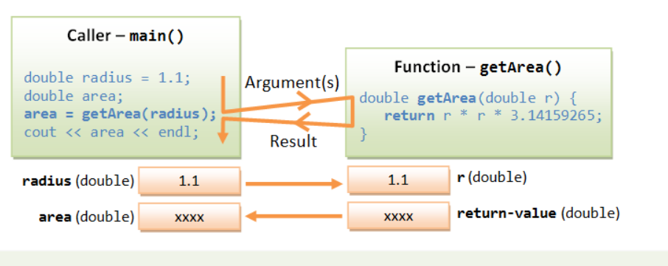

Slide 57
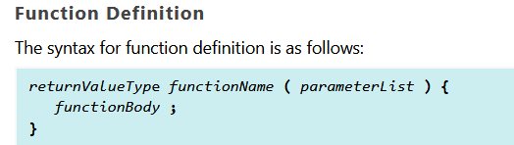

Slide 58
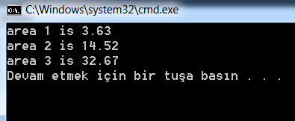
#include <iostream>
using namespace std;
const int PI = 3.14159265;
double getArea(double radius); // Function Prototype (Function Declaration)
int main() {
double radius1 = 1.1, area1, area2;
area1 = getArea(radius1); // call function getArea()
cout << "area 1 is " << area1 << endl;
area2 = getArea(2.2); // call function getArea()
cout << "area 2 is " << area2 << endl;
cout << "area 3 is " << getArea(3.3) << endl; // call function getArea()
}
// Function Definition// Return the area of a circle given its radius
double getArea(double radius) {
return radius * radius * PI;
}

Slide 59
Default Arguments
C++ introduces so-called default arguments for functions.
These default values would be used if the caller omits the corresponding actual argument in calling the function.
Default arguments are specified in the function prototype, and cannot be repeated in the function definition.
The default arguments are resolved based on their positions. Hence, they can only be used to substitute the trailing arguments to avoid ambiguity.

Slide 60
#include <iostream>/* Test Function default arguments */
using namespace std;
int fun1(int = 1, int = 2, int = 3); // Function prototype - Specify the default arguments here
int fun2(int, int, int = 3);
int main() {
cout << fun1(4, 5, 6) << endl; // No default
cout << fun1(4, 5) << endl; // 4, 5, 3(default)
cout << fun1(4) << endl; // 4, 2(default), 3(default)
cout << fun1() << endl; // 1(default), 2(default), 3(default)
cout << fun2(4, 5, 6) << endl; // No default
cout << fun2(4, 5) << endl; // 4, 5, 3(default)
// cout << fun2(4) << endl; // error: too few arguments to function 'int fun2(int, int, int)'
}
int fun1(int n1, int n2, int n3) {
return n1 + n2 + n3; // cannot repeat default arguments in function definition
}
int fun2(int n1, int n2, int n3) {
return n1 + n2 + n3;
}

Slide 61
Function Overloading
C++ introduces function overloading (or function polymorphism, which means many forms), which allows you to have multiple versions of the same function name, differentiated by the parameter list (number, type or order of parameters).
The version matches the caller's argument list will be selected for execution.

Slide 62
/* Test Function Overloading (FunctionOverloading.cpp) */
#include <iostream>
using namespace std;
void fun(int, int, int); // Version 1
void fun(double, int); // Version 2
void fun(int, double); // Version 3
int main() {
fun(1, 2, 3); // version 1
fun(1.0, 2); // version 2
fun(1, 2.0); // version 3
fun(1.1, 2, 3); // version 1 - double 1.1 casted to int 1 (without warning)

Slide 63
// fun(1, 2, 3, 4); // error: no matching function for call to 'fun(int, int, int, int)'
// fun(1, 2); // error: call of overloaded 'fun(int, int)' is ambiguous
// note: candidates are:
// void fun(double, int) // void fun(int, double)
// fun(1.0, 2.0); // error: call of overloaded 'fun(double, double)' is ambiguous
}
void fun(int n1, int n2, int n3) { // version 1
cout << "version 1" << endl;
}
void fun(double n1, int n2) { // version 2
cout << "version 2" << endl;
}
void fun(int n1, double n2) { // version 3
cout << "version 3" << endl;
}

Slide 64
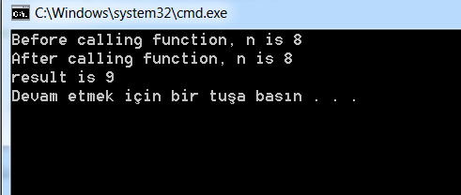
Pass-by-Value vs. Pass-by-Reference
In pass-by-value, a "copy" of argument is created and passed into the function. The invoked function works on the "clone", and cannot modify the original copy. - there is no side effect.
#include <iostream>/* Fundamental types are passed by value into Function*/
using namespace std;
int inc(int number); // Function prototypes
// Test Driver
int main() {
int n = 8;
cout << "Before calling function, n is " << n << endl; // 8
int result = inc(n);
cout << "After calling function, n is " << n << endl; // 8
cout << "result is " << result << endl; // 9
}
int inc(int number) {// Function definitions // Return number+1
++number; // Modify parameter, no effect to caller
return number;
}

Slide 65
Pass-by-Reference
In pass-by-reference, a reference of the caller's variable is passed into the function. In other words, the invoked function works on the same data.
If the invoked function modifies the parameter, the same caller's copy will be modified as well.
In C/C++, arrays are passed by reference. That is, you can modify the contents of the caller's array inside the invoked function - there could be side effect in passing arrays into function.
C/C++ does not allow functions to return an array. Hence, if you wish to write a function that modifies the contents of an array you need to rely on pass-by-reference to work on the same copy inside and outside the function.
Recall that in pass-by-value, the invoked function works on a clone copy and has no way to modify the original copy.

Slide 66
/* Function to increment each element of an array */
#include <iostreamusing namespace std; >
void inc(int array[], int size);
void print(int array[], int size);
int main() {
int a1[] = {8, 4, 5, 3, 2};
// Before increment
print(a1, 5); // {8,4,5,3,2}
// Array is passed by reference
// Do increment
inc(a1, 5);
// After increment
print(a1, 5); // {9,5,6,4,3}}
void inc(int array[], int size) {
for (int i = 0; i < size; ++i) {
array[i]++;
}
}
void print(int array[], int size) {
cout << "{";
for (int i = 0; i < size; ++i) {
cout << array[i];
if (i < size - 1) {
cout << ",";
}
}
cout << "}" << endl;
}
Array is passed into function by reference. That is, the invoked function works on the same copy of the array as the caller. Hence, changes of array inside the function is reflected outside the function.

Slide 67
const Function Parameters
Pass-by-reference risks corrupting the original data. If you do not have the intention of modifying the arrays inside the function, you could use the const keyword in the function parameter. A const function argument cannot be modified inside the function.
#include <iostream>
using namespace std;
int linearSearch(const int a[], int size, int key);
int main() {
const int SIZE = 8;
int a1[SIZE] = {8, 4, 5, 3, 2, 9, 4, 1};
cout << linearSearch(a1, SIZE, 8) << endl; // 0
cout << linearSearch(a1, SIZE, 4) << endl; // 1
cout << linearSearch(a1, SIZE, 99) << endl; // 8 (not found)
}
// Search the array for the given key// If found, return array index [0, size-1]; otherwise, return size
int linearSearch(const int a[], int size, int key) {
for (int i = 0; i < size; ++i) {
if (a[i] == key) return i;
}
return size;
}

Slide 68
Pass-by-Reference via "Reference" Parameters
#include <iostream>/* Test Pass-by-reference for fundamental-type parameter via reference declaration */
using namespace std;
int squareByValue (int number); // Pass-by-value
void squareByReference (int & number); // Pass-by-reference
int main() {
int n1 = 8;
cout << "Before call, value is " << n1 << endl; // 8
cout << squareByValue(n1) << endl; // no side-effect
cout << "After call, value is " << n1 << endl; // 8
int n2 = 9;
cout << "Before call, value is " << n2 << endl; // 9
squareByReference(n2); // side-effect
cout << "After call, value is " << n2 << endl; // 81
}
int squareByValue (int number) {// Pass parameter by value - no side effect
return number * number;
}
void squareByReference (int & number) {// Pass parameter by reference by declaring as reference (&)// - with side effect to the caller
number = number * number;
}

Slide 69
File Input/Output (Header <fstream>)
The <fstream> header provides ifstream (input file stream) and ofstream (output file stream) for file input and output.
The steps for file input/output are:
Create a ifstream for input, or ofstream for output.
Connect the stream to an input or output file via open(filename).
Perform formatted output via stream insertion operator <<, or input via stream extraction operator >>, similar to cout << and cin >>.
Close the file and free the stream.

Slide 70
/* Test File I/O Read all the integers from an input file and write the average to an output file */
#include <iostream>
#include <fstream> // file stream
#include <cstdlib>
using namespace std;
int main() {
ifstream fin; // Input stream
ofstream fout; // Output stream
fin.open("in.txt"); // Try opening the input file
if (!fin.is_open()) {
cerr << "error: open input file failed" << endl;
abort(); // Abnormally terminate the program (in <cstdlib>)
}
int sum = 0, number, count = 0;
while (!(fin.eof())) {
fin >> number; // Use >> to read
sum += number;
++count;
}

Slide 71
double average = double(sum) / count;
cout << "Count = " << count << " average = " << average << endl;
fin.close();
// Try opening the output file
fout.open("out.txt");
if (!fout.is_open()) {
cerr << "error: open output file failed" << endl;
abort();
}
// Write the average to the output file using <<
fout << average;
fout.close();
return 0;
}

Slide 72
Namespace
When you use different library modules, there is always a potential for name crashes, as different library may use the same name for different purposes.
This problem can be resolved via the use of namespace in C++. A namespace is a collection for identifiers under the same naming scope. (It is known as package in UML and Java.)
The entity name under a namespace is qualified by the namespace name, followed by :: (known as scope resolution operator), in the form of namespace::entityName.
// create a namespace called myNamespace for the enclosed entities
namespace myNameSpace {
int foo; // variable
int f() { ...... }; // function
class Bar { ...... }; // compound type such as class and struct
}
// To reference the entities, use
myNameSpace::foo
myNameSpace::f()
myNameSpace::Bar
A namespace can contain variables, functions, arrays, and compound types such as classes and structures.

Slide 73

#include <iostream>
using namespace std;
namespace first // Variable created inside namespace
{
int val = 500;
}
// Global variable
int val = 100;
int main() {
int val = 200; // Local variable
// These variables can be accessed from
// outside the namespace using the scope
// operator ::
cout << first::val << '\n';
return 0;
}

Slide 74
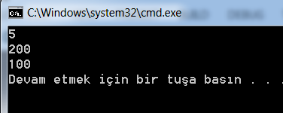
#include <iostream>
using namespace std;
namespace ns1 {
int value() { return 5; }
}
namespace ns2 {
const double x = 100;
double value() { return 2*x; }
}
int main() {
cout << ns1::value() << '\n'; // Access value function within ns1
cout << ns2::value() << '\n'; // Access value function within ns2
cout << ns2::x << '\n'; // Access variable x directly
return 0;
}

Slide 75
Using Namespace
For example, all the identifiers in the C++ standard libraries (such as cout, endl and string) are placed under the namespace called std. To reference an identifier under a namespace, you have three options:
Use the fully qualified names, such as std::cout, std::endl, std::setw() and std::string. For example,
std::cout << std::setw(6) << 1234 << std::endl;
Missing the "std::" results in "error: 'xxx' was not declared in this scope".
Use a using declaration to declare the particular identifiers. For example,
using std::cout;
using std::endl;
......
cout << std::setw(6) << 1234 << endl;
You can omit the "std::" for cout and endl, but you still have to use "std::" for setw.
Use a using namespace directive. For example,
using namespace std;
......
cout << setw(6) << 1234 << endl;
The using namespace directive effectively brings all the identifiers from the specified namespace to the global scope, as if they are available globally. You can reference them without the scope resolution operator. Take note that the using namespace directive may result in name crashes with identifier in the global scope.
For long namespace name, you could define a shorthand (or alias) to the namespace, as follows:
namespace shorthand = namespace-name;

Slide 76
Enumeration (enum)
An enum is a user-defined type of a set of named constants, called enumerators. An enumeration define the complete set of values that can be assigned to objects of that type. For example,
enum Color {
RED, GREEN, BLUE
} myColor; // Define an enum and declare a variable of the enum
......
myColor = RED; // Assign a value to an enum
Color yourColor;
yourColor = GREEN;
The enumerators are represented internally as integers. You have to use the names in assignment, not the numbers.
However, it will be promoted to int in arithmetic operations. By default, they are running numbers starting from zero. You can assigned different numbers, e.g.,
enum Color {
RED = 1, GREEN = 5, BLUE
};
To print the enumerator names, you may need to define a array of string, indexed by the enumerator numbers.

Slide 77

#include <iostream>
using namespace std;
enum week { Sunday, Monday, Tuesday, Wednesday, Thursday, Friday, Saturday };
int main()
{
week today;
today = Wednesday;
cout << "Day " << today+1;
return 0;
}

Slide 78
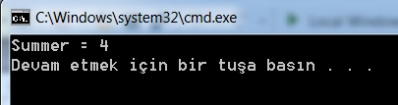
#include <iostream>
using namespace std;
enum seasons { spring = 34, summer = 4, autumn = 9, winter = 32};
int main() {
seasons s;
s = summer;
cout << "Summer = " << s << endl;
return 0;
}

Slide 79
2021-EK

Slide 80
Kontrol Yapıları
While(): Mutlaka bir test değeri içermelidir ki while döngüsü bir sefer yanlış olmalı ve döngü sona ermelidir. Aksi halde sonsuz döngü oluşur.
Sayi=1;
While(sayi<20)
{
Printf(“sayıyoruz işte,%d\n”,sayi)
}
Döngü ne zaman biter?

Slide 81
Kontrol Yapıları
#include <stdio.h>
int main(void)
{
int n = 5;
while (n < 7) // satır5
{
printf("n = %d\n", n);
n++; // satır 8
printf(“Simdi n = %d\n", n); // satır 9
}
printf(“Dongu biter, n=%d.\n“,n);
return 0;
}

Slide 82
Kontrol Yapıları
Döngüye giriş koşulu iyi ayarlanmalı:
index = 10;
while (index++ < 5)
printf(“iyi gunler dileriz.\n");
Döngüden çıkış olmalı
#include <stdio.h>
int main(void)
{
int n = 0;
while (n < 3)
printf("n = %d\n", n);
n++;
printf(“yapilanin hepsi bu\n");
return 0;
}

Slide 83
Kontrol Yapıları
#include <stdio.h>
int main(void)
{
int n = 0;
while (n++ < 3)
printf("n = %d\n", n);
printf(“yapilanin hepsi bu\n");
return 0;
}

Slide 84
Kontrol Yapıları
#include <stdio.h>
int main(void)
{
int num = 1;
while (num < 21)
{
printf("%d %d\n", num, num * num);
num = num + 1;
}
return 0;
}

Slide 85
#include <stdio.h>
#define MAX 100
int main(void)
{
int count = MAX + 1;
while (--count > 0)
{
printf("%d sise su rafta duruyor, " "%d sise su!\n", count, count);
printf(“bir tanesi kirildi,\n");
printf("%d sise su kaldi!\n\n", count - 1);
}
return 0;
}

Slide 86
Biraz da Eğlenin
4) Hataları bulun
int main(void)
{
int i = 1, float n;
printf(“Bazı hatlar olabilir, bulun onları!\n");
while (i < 30)
n = 1/i;
printf(" %f", n);
printf(“Hepsi bu kadar!\n");
return;
}

Slide 87
While() ve Mantık
Dikkat edilmesi gereken noktalar:
= ve == birbirinden farklı
Bazı öngüler sonsuz bazıları sayılı olarak tanımlıdırlar;
#include <stdio.h>
int main(void)
{
const int NUMBER = 22;
int count = 1;
while (count <= NUMBER)
{
printf(“Arkadaşım olurmusun!\n");
count++;
}
return 0;
}

Slide 88
While()
Dikkat edilmesi gereken noktalar:
Bir sayıcı olmalı,
Bu sayıcı bir sınır değeri ile karşılaştırılmalı
Bu sayıcı döngünün her seferinde artırılmalı
Note: Sayıcı her zaman döngü dışında tanımlanır ve değer atanır. Sayıcının değerinin artırılması
while(sayıcı++<Limit)
şeklinde olabilir veya açık olarak döngü içerisinde yapılır.
Bu durumları for döngüsü ortadan kaldırır.

Slide 89
For() döngüsü
For() döngüsü sayıcı tanımlama-değer atama, test ve sayıcı değer artırımını aynı yerde yapar.
#include <stdio.h>
int main(void)
{
const int NUMBER = 22;
int count;
for (count = 1; count <= NUMBER; count++)
printf(“Arkadaşım olurmusun!\n");
return 0;
}

Slide 90
For() döngüsü
#include <stdio.h>
int main(void)
{
int num;
printf(" n n kupu\n");
for (num = 1; num <= 6; num++)
printf("%d %d\n", num, num*num*num);
return 0;
}

Slide 91
For() döngüsü
For() döngüsü değişik şekillerde kullanılabilir:
#include <stdio.h>
int main(void)
{
int saniye;
for (saniye = 5; saniye > 0; saniye --)
printf("%d saniyeler!\n", saniye);
printf(“Boooooom!\n");
return 0;
}

Slide 92
For() döngüsü
Artırmayı bir yapmak zorunda değilsiniz.
#include <stdio.h>
int main(void)
{
int n;
for (n = 2; n < 60; n = n + 13)
printf("%d \n", n);
return 0;
}

Slide 93
For() döngüsü
Sayılar yerine karakterleri sayabilirsiniz
#include <stdio.h>
int main(void)
{
char ch;
for (ch = 'a'; ch <= 'z'; ch++)
printf(" %c nin ASCII değeri %d.\n", ch, ch);
return 0;
}

Slide 94
For() döngüsü
For() döngüsünü test için kullanabilirsiniz (sadece saymaları yapmıyor yani)
#include <stdio.h>
int main(void)
{
int num;
printf(" n n kupu\n");
for (num = 1; num*num*num <= 216; num++)
printf("%d %d\n", num, num*num*num);
return 0;
}

Slide 95
For() döngüsü
Artırım aritmetik veya geometrik olarak seçilebilir:
#include <stdio.h>
int main(void)
{
double d;
for (d = 100.0; d < 150.0; d = d * 1.1)
printf(“d niz simdi %f\n", d);
return 0;
}

Slide 96
For() döngüsü
Artırma yerine istediğiniz legal işlemi koyabilirsiniz:
#include <stdio.h>
int main(void)
{
int x;
int y = 55;
for (x = 1; y <= 75; y = (++x * 5) + 50)
printf("%d %d\n", x, y);
return 0;
}

Slide 97
For() döngüsü
Sonsuz döngü
for (; ; )
printf(“Biri beni durdursun\n");

Slide 98
For() döngüsü
İlk sayı değer ataması olmak zorunda değildir.
Bu kısım sadece bir defa işlem görür.
Buraya istediğiniz başka bir işlem koyabilirsiniz
#include <stdio.h>
int main(void)
{
int num = 0;
for (printf(“benim istedigim sayiyi girin!\n"); num != 6; )
scanf("%d", &num);
printf(“İste istedigim sayi bu!\n");
return 0;
}

Slide 99
For() döngüsü
Döngü parametreleri döngü içerisinde döngü çalışırken değiştirilebilirler:
for (n = 1; n < 10000; n = n + degisken)
Değer atama operatörleri (ilaveler)
+=
-=
*=
/=
%=

Slide 100
For() döngüsü
For() döngüsünü birden fazla değer için kullanabilirsiniz
#include <stdio.h>
int main(void)
{
const int ilk= 37;
const int ikinci = 23;
int kg, eder;
printf(" kg eder\n");
for (kg=1, eder=ilk; kg <= 16; kg++, eder += ikinci)
printf("%5d $%4.2f\n", ounces, cost/100.0);
return 0;
}

Slide 101
Do while döngüsü
#include <stdio.h>
int main(void)
{
const int sifre = 13;
int girilen_sifre;
do
{
printf(“Bilgisayar kulubune uye olmak icin,\n");
printf(“gizli sifreyi giriniz: ");
scanf("%d", & girilen_sifre);
} while (girilen_sifre != sifre);
printf(“Tebrikler artik uyesiniz!\n");
return 0;
}

Slide 102
Hangisi
for() ve while() döngüleri giriş-şartlı döngülerdir.
Şart daha başlangıçta test edilir, eğer giriş şartı sağlanmıyorsa döngü işlemez.
do() while() döngüsü ise çıkış-şartlı bir döngüdür. İşlem en az bir kez yapılır.
Giriş şartlı: while or for?
Hangis size uyarsa!!

Slide 103
Hangisi
For( ;test;)=while(test)
İlk
While(test)
{
İşlemler
Artır
}
=
for( ilk; test; artır)
işlemler

Slide 105
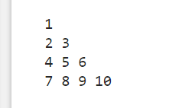
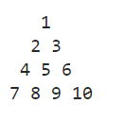
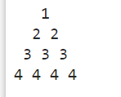
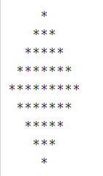

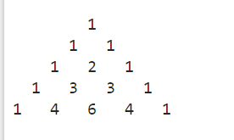

Slide 106
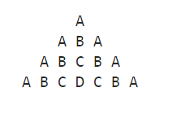
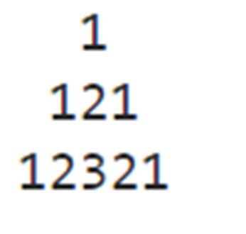

Slide 107
#include <stdio.h>
void main()
{
int i,j,rows,k=1;
printf("Input number of rows : ");
scanf("%d",&rows);
for(i=1;i<=rows;i++)
{
for(j=1;j<=i;j++)
printf("%d ",k++);
printf("\n");
}
}

Slide 108
#include <stdio.h>
void main()
{
int i,j,spc,rows,k,t=1;
printf("Input number of rows : ");
scanf("%d",&rows);
spc=rows+4-1;
for(i=1;i<=rows;i++)
{
for(k=spc;k>=1;k--)
{
printf(" ");
}
for(j=1;j<=i;j++)
printf("%d ",t++);
printf("\n");
spc--;
}
}

Slide 109
#include <stdio.h>
void main()
{
int i,j,spc,rows,k;
printf("Input number of rows : ");
scanf("%d",&rows);
spc=rows+4-1;
for(i=1;i<=rows;i++)
{
for(k=spc;k>=1;k--)
{
printf(" ");
}
for(j=1;j<=i;j++)
printf("%d ",i);
printf("\n");
spc--;
}
}

Slide 110
#include <stdio.h>
void main()
{
int i,j,n,p,q;
printf("Input number of rows : ");
scanf("%d",&n);
for(i=1;i<=n;i++)
{
if(i%2==0)
{ p=1;q=0;}
else
{ p=0;q=1;}
for(j=1;j<=i;j++)
if(j%2==0)
printf("%d",p);
else
printf("%d",q);
printf("\n");
}
}

Slide 111
#include <stdio.h>
void main()
{
int i,j,r;
printf("Input number of rows (half of the diamond) :");
scanf("%d",&r);
for(i=0;i<=r;i++)
{
for(j=1;j<=r-i;j++)
printf(" ");
for(j=1;j<=2*i-1;j++)
printf("*");
printf("\n");
}
for(i=r-1;i>=1;i--)
{
for(j=1;j<=r-i;j++)
printf(" ");
for(j=1;j<=2*i-1;j++)
printf("*");
printf("\n");
}
}

Slide 112
#include <stdio.h>
void main()
{
int no_row,c=1,blk,i,j;
printf("Input number of rows: ");
scanf("%d",&no_row);
for(i=0;i<no_row;i++)
{
for(blk=1;blk<=no_row-i;blk++)
printf(" ");
for(j=0;j<=i;j++)
{
if (j==0||i==0)
c=1;
else
c=c*(i-j+1)/j;
printf("% 4d",c);
}
printf("\n");
}
}

Slide 113
#include <stdio.h>
void main()
{
int i,j,n;
printf("Input number of rows : ");
scanf("%d",&n);
for(i=0;i<=n;i++)
{
/* print blank spaces */
for(j=1;j<=n-i;j++)
printf(" ");
/* Display number in ascending order upto middle*/
for(j=1;j<=i;j++)
printf("%d",j);
/* Display number in reverse order after middle */
for(j=i-1;j>=1;j--)
printf("%d",j);
printf("\n");
}
}

Slide 114
#include <stdio.h>
void main()
{
int i, j;
char alph = 'A';
int n,blk;
int ctr = 1;
printf("Input the number of Letters (less than 26) in the Pyramid : ");
scanf("%d", &n);
for (i = 1; i <= n; i++)
{
for(blk=1;blk<=n-i;blk++)
printf(" ");
for (j = 0; j <= (ctr / 2); j++) {
printf("%c ", alph++);
}
alph = alph - 2;
for (j = 0; j < (ctr / 2); j++) {
printf("%c ", alph--);
}
ctr = ctr + 2;
alph = 'A';
printf("\n");
}
}

